Slide 1
Case Study 3 – Insurance Premium Data
Problem Statement
The Insurance industry is worth billions of dollars by market estimate. Large insurance companies could make use of comprehensive data to understand policy holder’s characteristics, needs and assess the risks involved in insuring them. On the other hand, startup insurance companies may not have large amount of data and resources to understand the reasons on why are they not being profitable. This could be due to the fact that policyholder claims exceeded their insurance premium, which reduced company’s profit. This case study aims to find out the various reasons and factors that contributes to the high beneficiary claims.
Notes:
NAME: LJW LAST 3 DIGIT OF NRIC: 38E

Slide 2
Source and Categorization of Data
Source of data was downloaded from online website (Kaggle), which is an online community of data scientists and machine learning practitioners. It is assumed to be trusted and accurate source, dated 9 September 2020.
Data was comprehensive and information provided were necessary for data analysis. Data was also consistent throughout 1338 rows and accuracy was supported with a good stratified sampling size of 1338 policy holders.
Age and BMI were further categorise into different groupings for better data analysis. Additional columns (Age_group and BMI_status) were added to the CSV file.
Age was classified into 4 categories as follow: Below 24 = Youth 25 – 40 = Millennials 41 – 56 = Gen X Above 57 = Boomers | BMI was classified into 3 categories as follow: Below 18.5 = Underweight 18.5 – 24.9 = Healthy Above 25 = Overweight

Slide 3
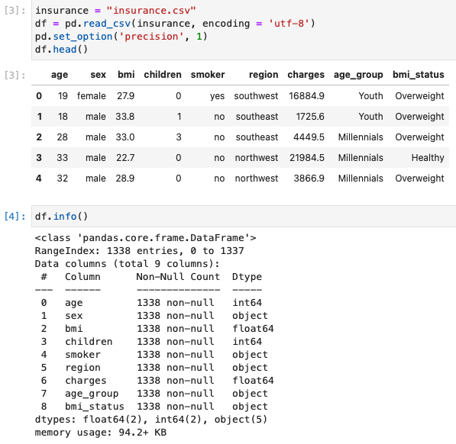
Exploratory Data Analysis (EDA)
Pandas function (pd.read_csv) was used to extract data from CSV file into Jupyter notebook. As the original data were in 5 decimal place, pd.set_option('precision', 1) was used to round up to 1 decimal place to look cleaner.
(df.info) was used to identify and check whether the existing dtypes are correct. Thereafter, column names were renamed for better clarity and look more presentable.
To ensure there is no missing or invalid value within the data, (df.isna.sum) was used to validate.
Notes:
Python code used:
insurance = "insurance.csv"
df = pd.read_csv(insurance, encoding = 'utf-8')
pd.set_option('precision', 1)
df.head()
df.info()
column_names = ['Age', 'Gender', 'BMI', "Children", 'Smoker', 'Region', 'Total_charges', 'Age_group', 'BMI_status']
df = pd.read_csv(insurance, names=column_names, skiprows=1)
df.head()
df.describe()
df.isnull().sum()

Slide 4
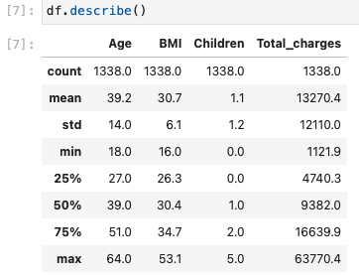
Exploratory Data Analysis (EDA)
(df.describe) was used to understand the descriptive statistics and helped to validate the absence of strange/incorrect values in the data set. Descriptive statistics such as mean, min and max, range of values of Age, BMI and Total charges can be seen clearly at one glance. Summary of initial statistics
Age Range: 18 – 64 years old
Body Mass Index (BMI) Range: 16 – 53.1
Total Insurance Premium Charges to the policyholder: $12110 - $63770.4
Among the fields in the dataset, Age, Gender, BMI, Smoker and Total_charges are relevant to approach the problem statement and will be the focus fields.
With the above steps taken, data integrity and quality is validated to proceed with chart plotting in Tableau

Slide 5
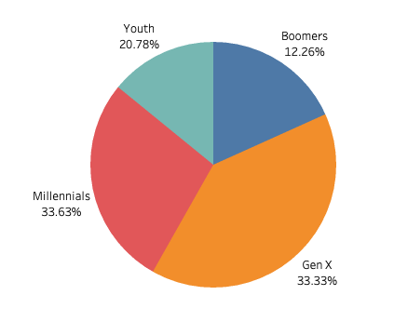
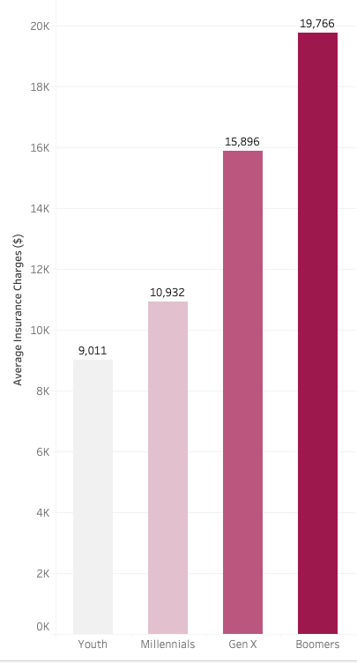
Tableau Dashboard
1) Main Group of Policyholders Based on the pie chart below, it was observed that Millennials and Generation X are the main group of policyholders in this dataset. | 2) Insurance Charges by Age Group Based on the bar chart below, it was observed that older policyholders (Boomers) are charged the highest insurance premium than the remaining age group. Boomers are charged 219% more insurance premium as compared to Youth.
Dashboard Link: https://public.tableau.com/app/profile/bob.lok/viz/CapstoneProject-LJW38E/InsurancePremiumCaptoneProjectStory?publish=yes
Notes:
Dashboard Link: https://public.tableau.com/app/profile/bob.lok/viz/CapstoneProject-LJW38E/InsurancePremiumCaptoneProjectStory?publish=yes

Slide 6
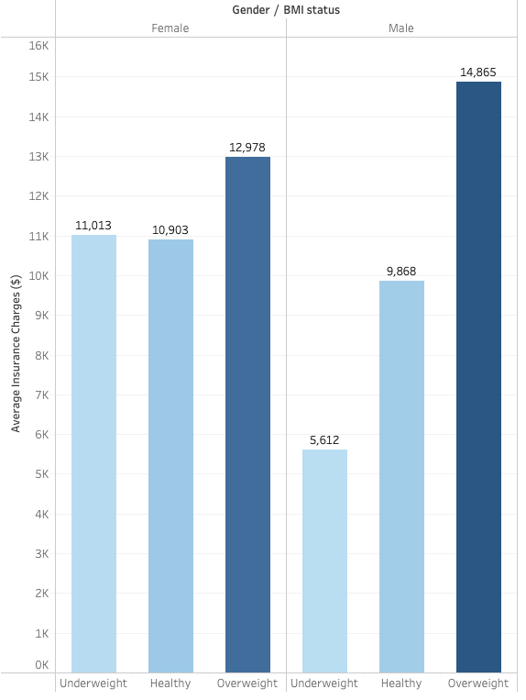
Tableau Dashboard
3) Insurance Charges by Gender / BMI Based on the side by side-by-side bar below, it was observed that policyholders who are overweight tend to be charged a higher insurance premium, regardless of their gender. | 4) Insurance Charges by Smokin Habit Based on the stacked bar chart below, it was observed that smokers (regardless of gender) is charged a much higher insurance premium compared to non-smoker (350% more for female and 408% more for male). It can
Notes:
Dashboard Link: https://public.tableau.com/app/profile/bob.lok/viz/CapstoneProject-LJW38E/InsurancePremiumCaptoneProjectStory?publish=yes

Slide 7

Findings
Based on the pie chart, it can be seen that the main group of customers belongs to policyholder age between 25 to 56. As individuals grow older, they will be more concern about their health and would purchase insurance to prepare for any unforeseen circumstances in the future.
Across different insurance premium charging criteria, Males are charged a higher percentage as compared to Females. This could be due to the fact that males generally have lower life expectancy as compared to females.
Lastly, noticed the higher insurance premium charges as individuals grows older. This is something inevitable as a person’s health starts to deteriorate and the increased probability of chronic diseases. The older age group (Boomers) requirement for medical services increases as they age, which corresponds to their cost of insurance premium.

Slide 8

Strategy: Key Recommendations
Based on the findings from the plotted charts, I would recommend startup insurance companies to increase insurance premium charges to new customers who are passive smokers. Other larges companies have been charging much higher insurance premium as they understand the high probability of insurance claims by smokers. This can be supported by the significant increase of insurance premium charges (350% and 408% for female and male respectively).
Another recommendation is to increase insurance premium charges to new customers who are overweight. Generally, people who are overweight tend to have unhealthy eating habits and do not exercise regularly. Large insurance companies understood that healthy people tend to fall sick less often and would not claim insurance unnecessarily From the chart, it was observed that individuals who are under healthy BMI category were charged lesser premium regardless of their gender (16% and 22.5% for female and male respectively)
Studies have also shown that individuals who are non-smoker and exercise regularly have a lower rate of develop terminal illness, thus reducing insurance claims. The charts support the assumption that smoking and unhealthy BMI contributes greatly to higher insurance charges. Startup insurance companies needs to be caution for this 2 group of customers as it will affect their profit maximization.

Slide 9
Impact of Recommendations and Considerations
The main impact of my recommendations would be increase of profit generation for startup insurance companies over the long run. They would be more capable of assessing potential future risks and prudent with quoting insurance premium charges to smokers and obese customers.
Startup insurance companies could consider implementing targeted marketing strategies to specific segment of customers such as those who are in healthy BMI range and non-smoker. Additional resources such as more comprehensive and large data is required in order to conduct more detailed analysis of customers to understand their needs and design customized insurance products that fits the customer. Higher budget may need to be allocated for overall product improvement and marketing campigns.
If recommendations work well, startup insurance companies would still need to continue collect customer data which are of high quality and integrity. It is a never-ending process to aid insurance companies to group people into different risk categories and charge them according to their risk profile. In order to achieve profit maximization, total insurance premium received must be higher than approved claims of policyholders.

Slide 10
Conclusion and Reflection
In conclusion, understanding characteristics of every customer is important. Using data analytics could help startup insurance companies to assess and group their customers according to their respective risk profile. There are various factors which contributes to customer’s insurance premium charges. Some factors are within customer’s control (BMI and smoking) while other factors such as gender and age is something that people are born with and cannot be change. All these needs to be take into consideration before offering insurance to new customers.
I have learnt the fundamental skills that every Data Analyst need in order to to transform complex sets of data into simplified and informative charts for senior management to make important decision. Learning Python, EDA steps, SQL and Tableau was very interesting and challenging at the same time. Selection of right visualization for different types of data is critical and helps in building strong storytelling skills to the target audience.
The main challenge was incorporating what we had learnt in the past 7 weeks into Capstone Project. More time and effort was required due to the lack of basic foundation. Nevertheless, I am thankful for the patience of the trainer (Praveen and Eric) and TAs in guiding us through this journey.

